Slide 1
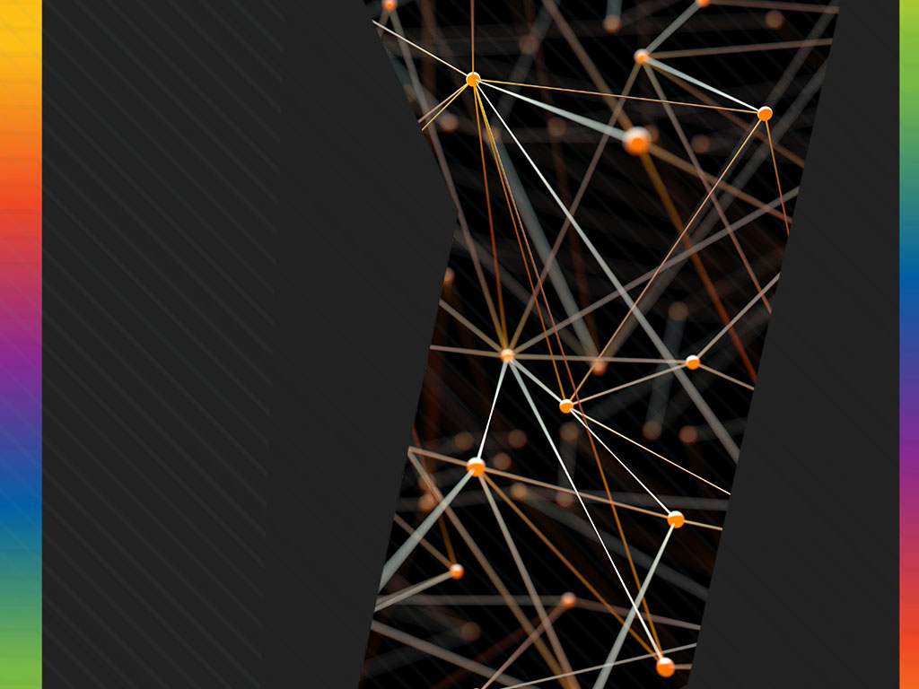
Structure from Motion🔥
Triangulation
Two-Frame Structure from Motion
Factorization

Slide 2
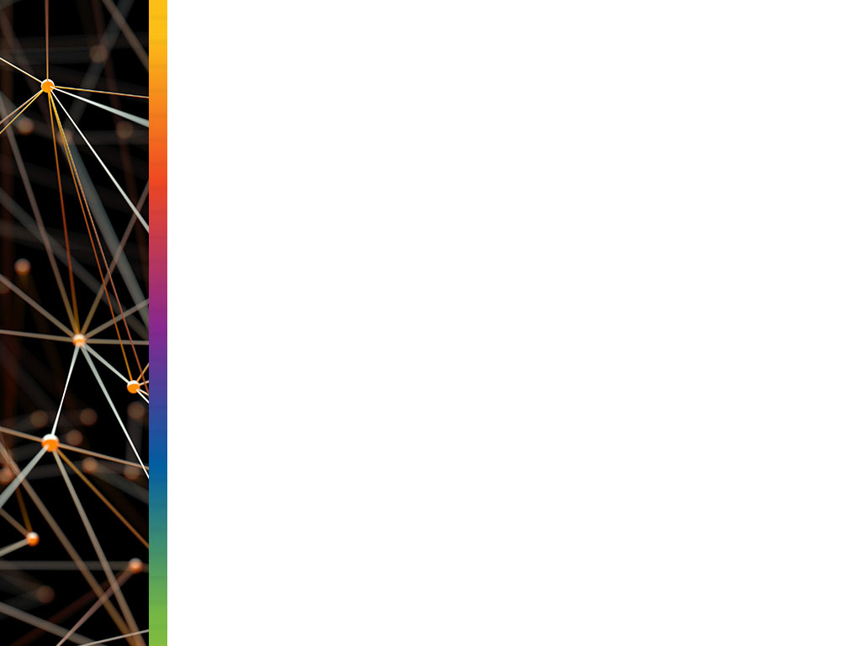
Shape From X:
Main Idea: Recovering 3D shape from some 2D images
There are many method to do that, and they are :
Stereo
Motion
Shading
Photometric Stereo
Texture
Contours
Silhouettes

Slide 3
Applications:🤔
Object Recognition
Robotics
Geo-localization
Archeology
Image Retrieval
Sports

Slide 4
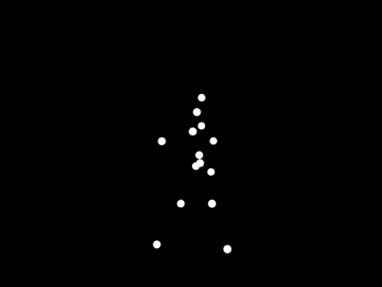
Moving Light Display:
This is the Motion of a Human in 3d.
Video Link: https://youtu.be/r0kLC-pridI

Slide 5

Application of Structure From Motion:
Video Link: https://youtu.be/i7ierVkXYa8

Slide 6
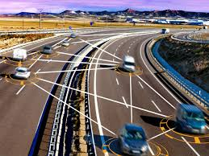
Triangulation:👉
The problem of determining a point’s 3D position from a set of corresponding image locations and known camera positions is known as triangulation.
It is also called as Reconstruction.

Slide 7
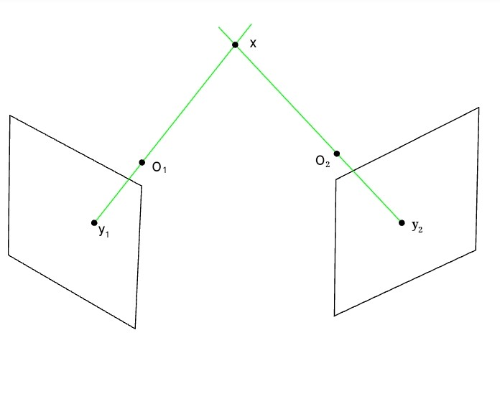
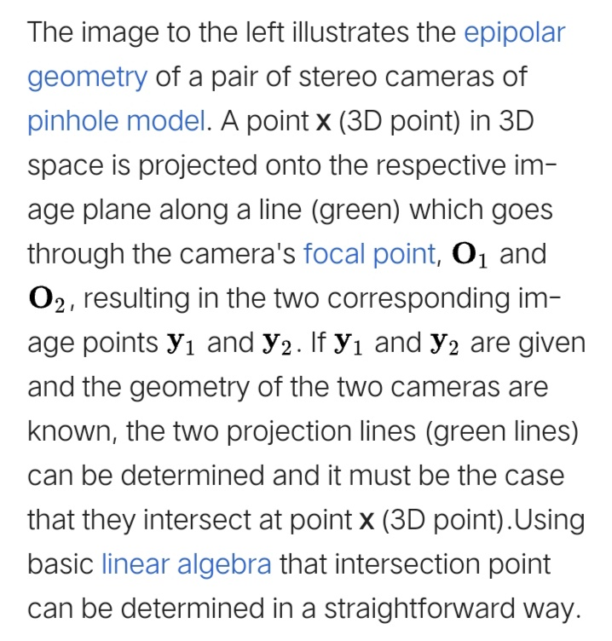
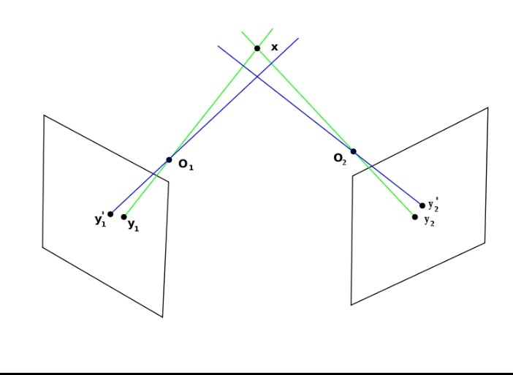
Illustration:
Img:1
Img:2

Slide 8
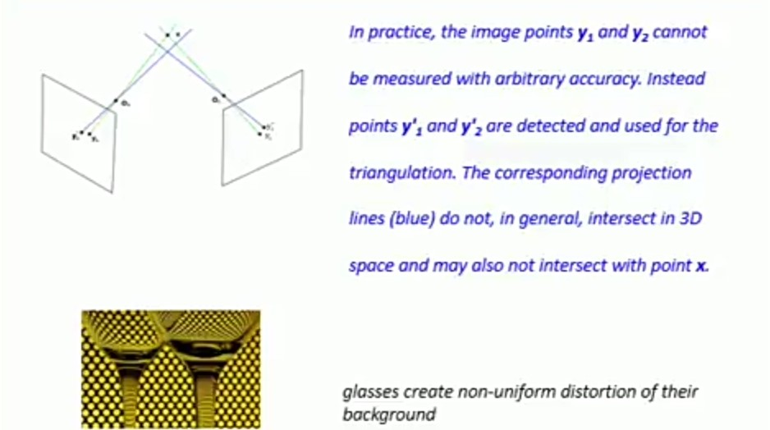

Slide 9
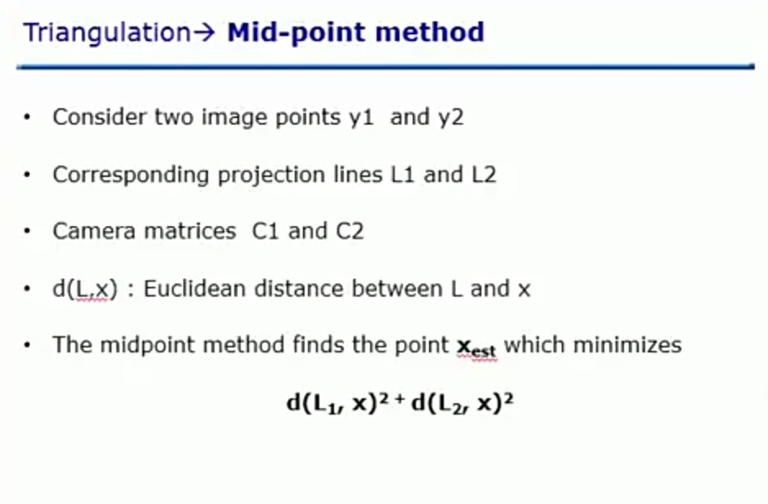

Slide 10
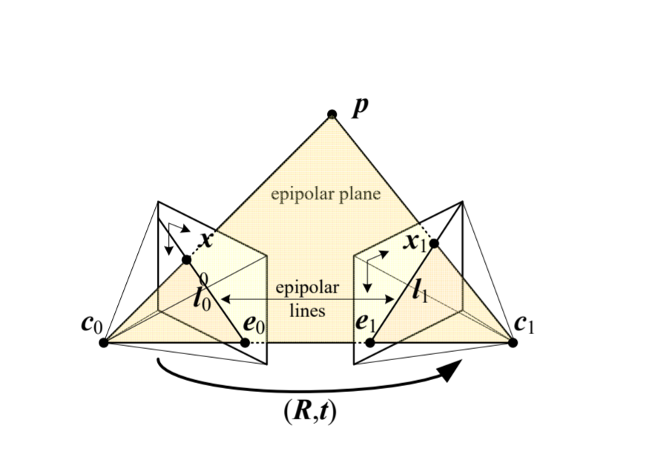
Two frame structure of motion:
Epipolar Geometry:

Slide 11
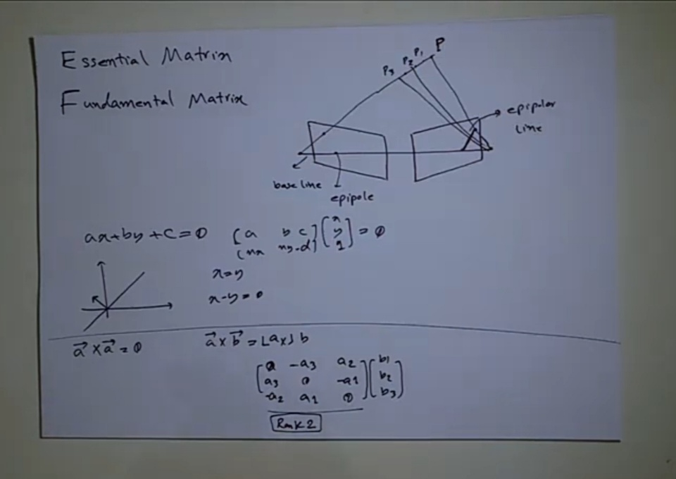

Slide 12
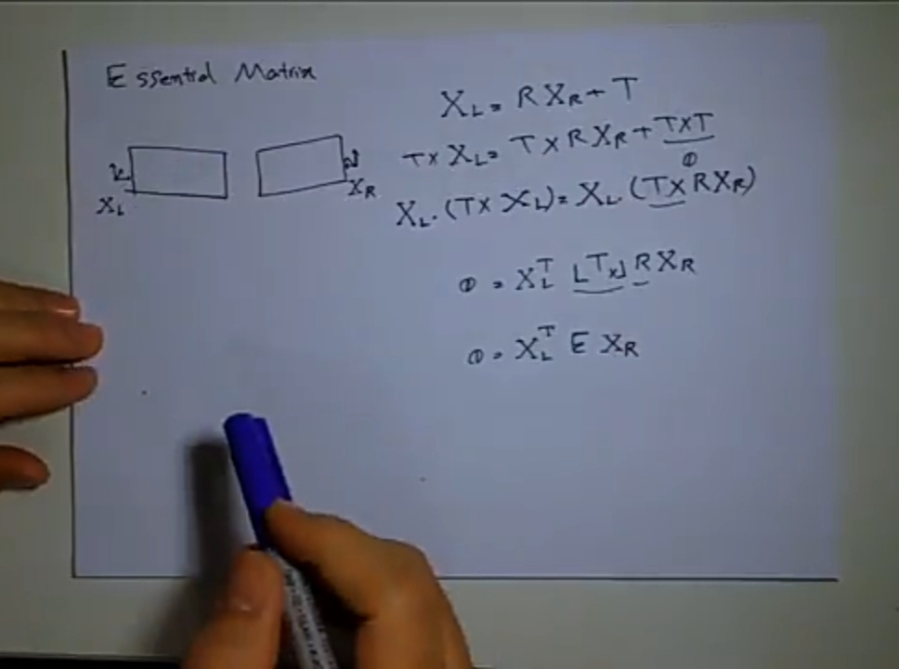

Slide 13
Thank You 👌

